Slide 1
Comp Photography (Fall 2015)
HW 5
Hieu Nguyen
CS 6475

Slide 2
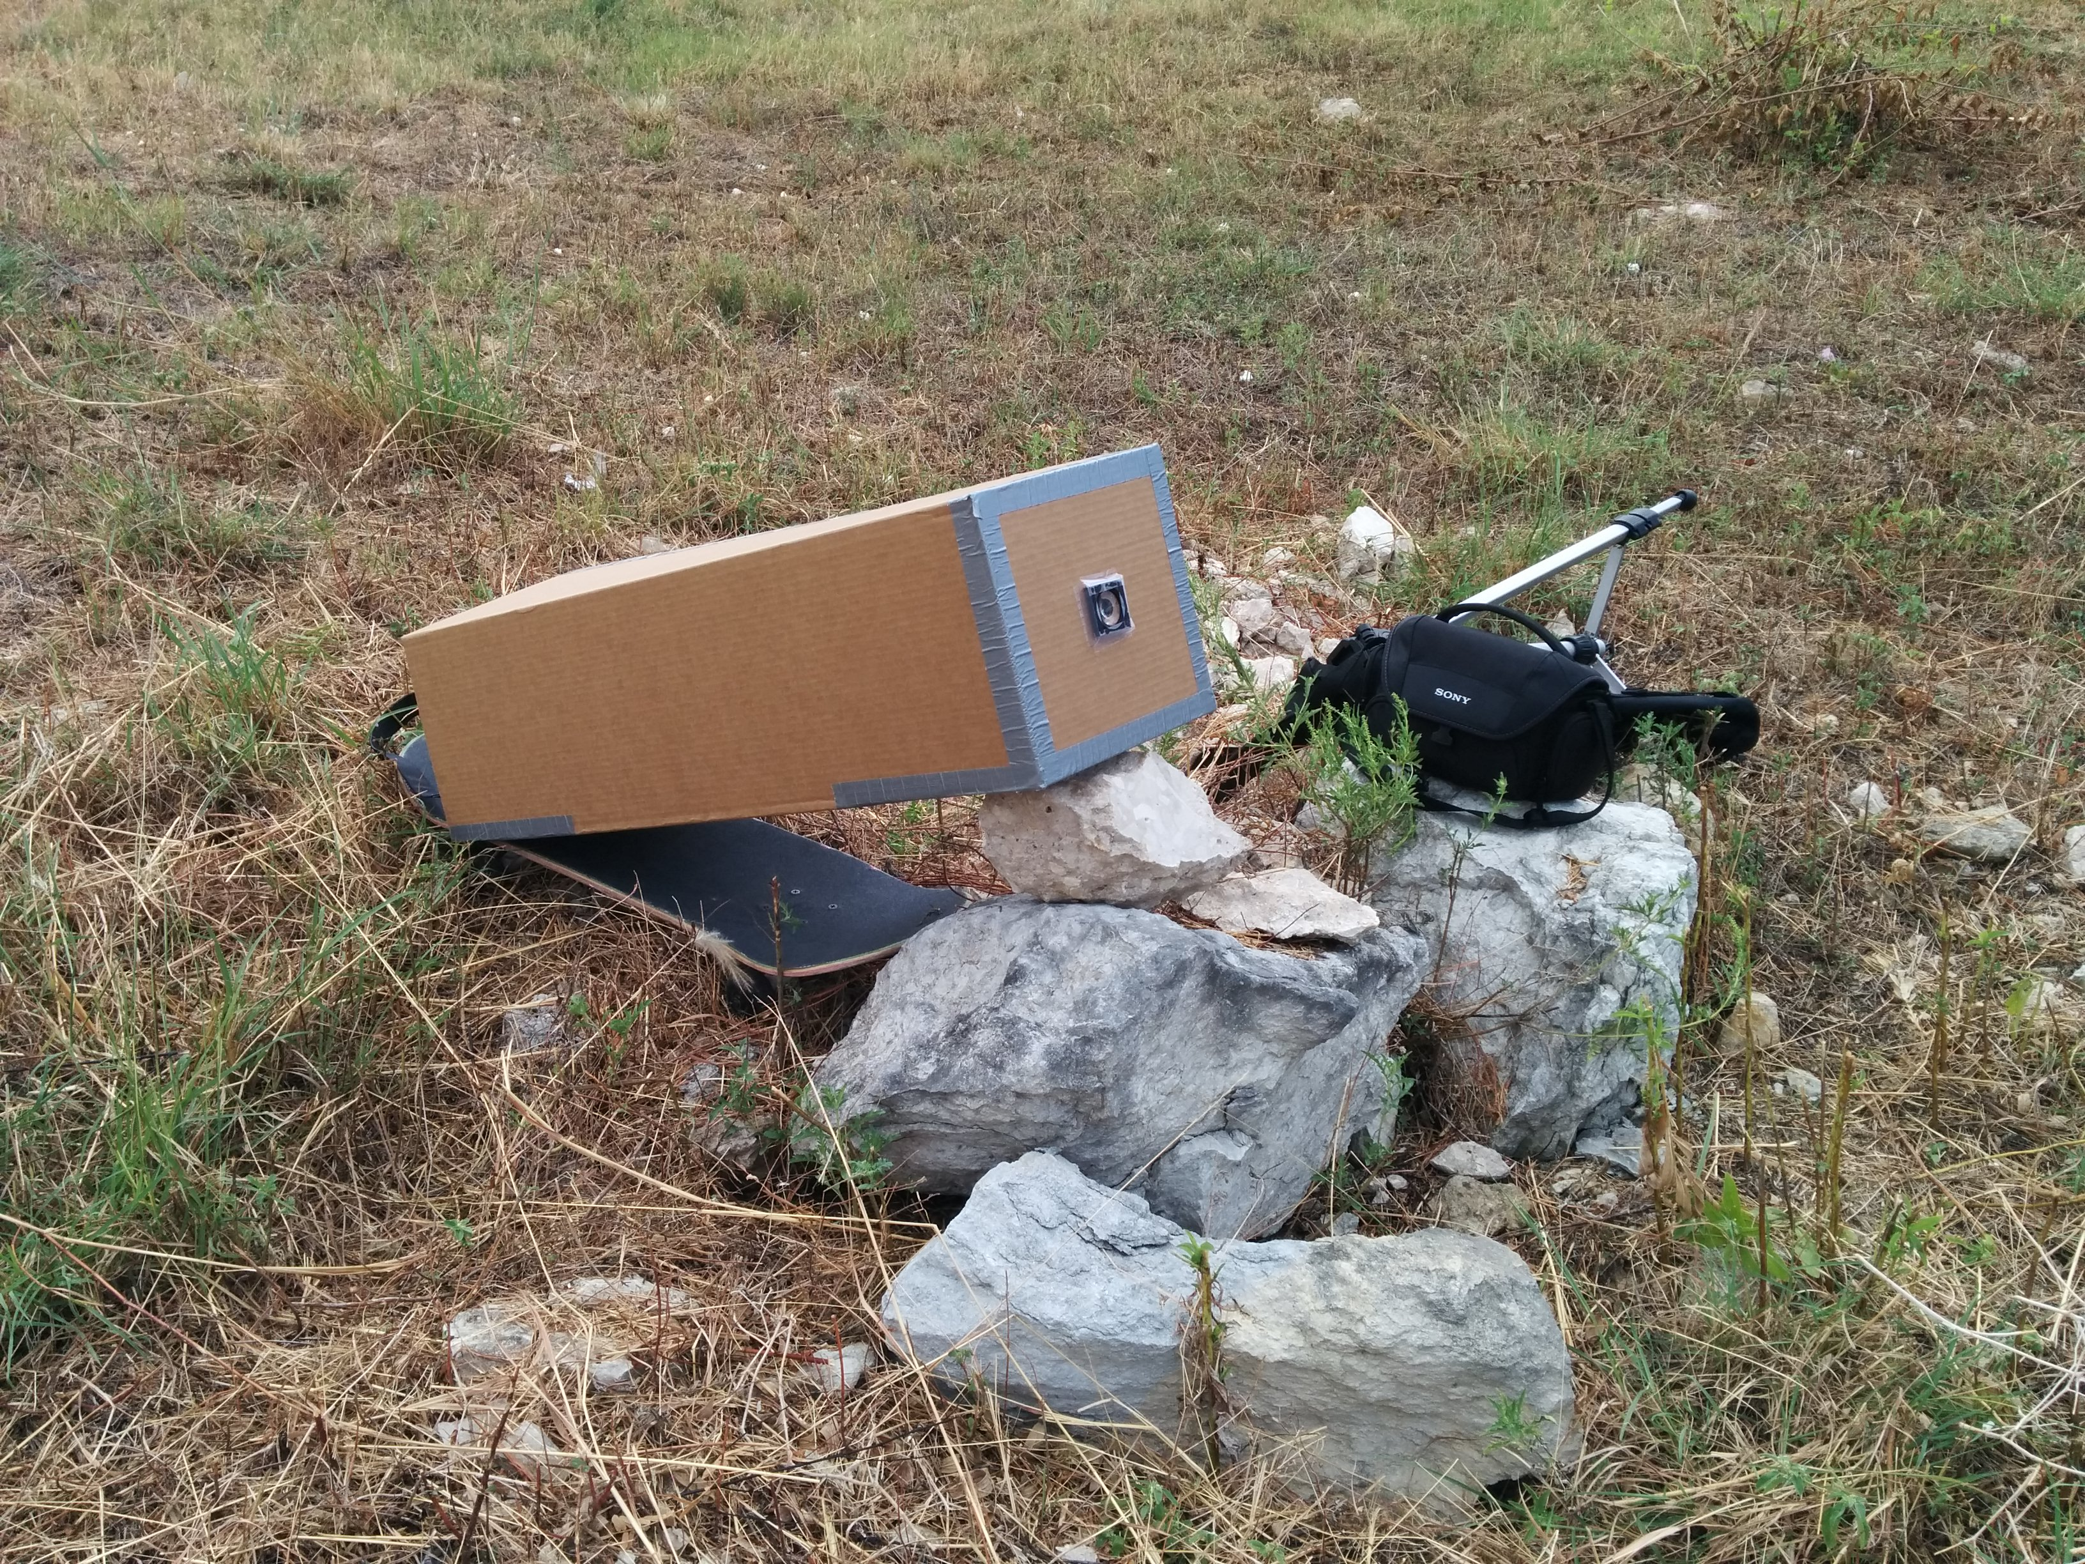
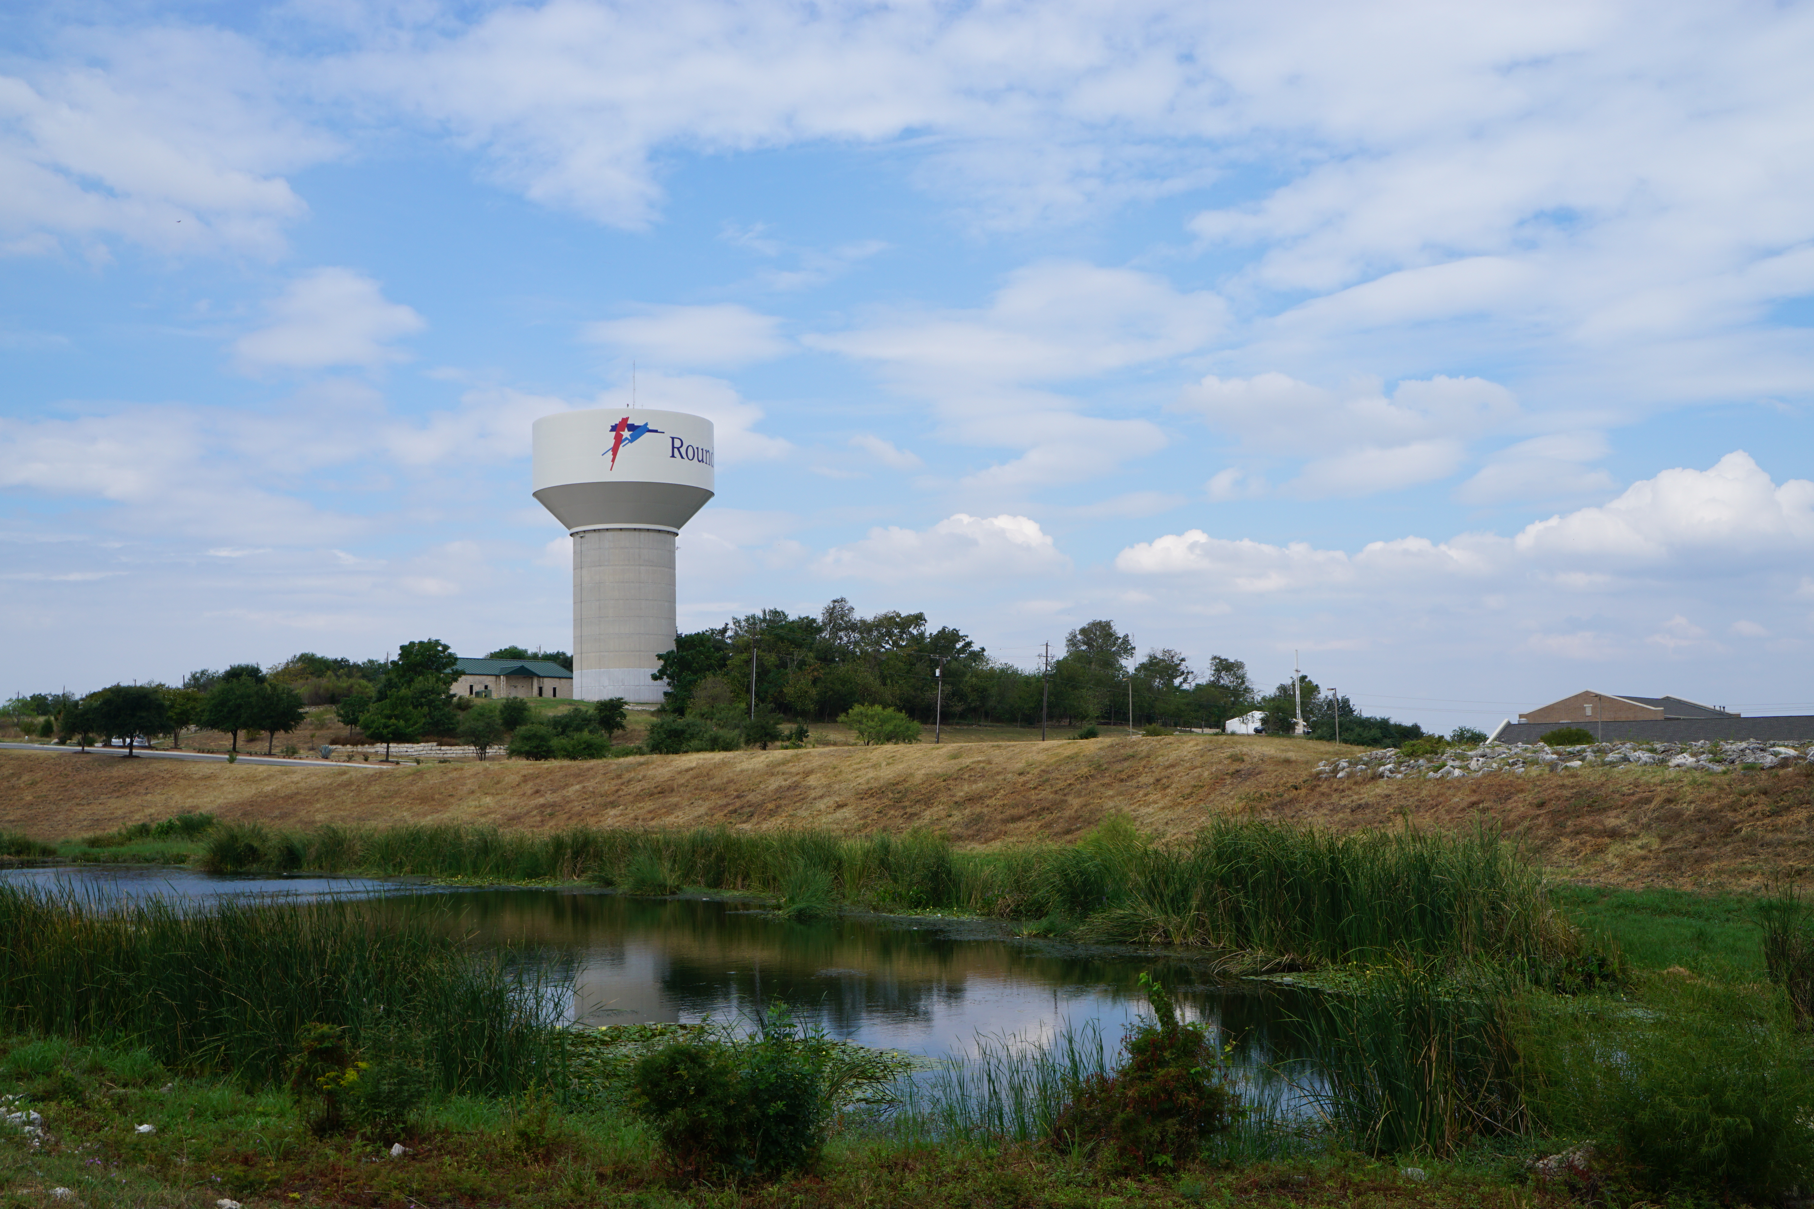
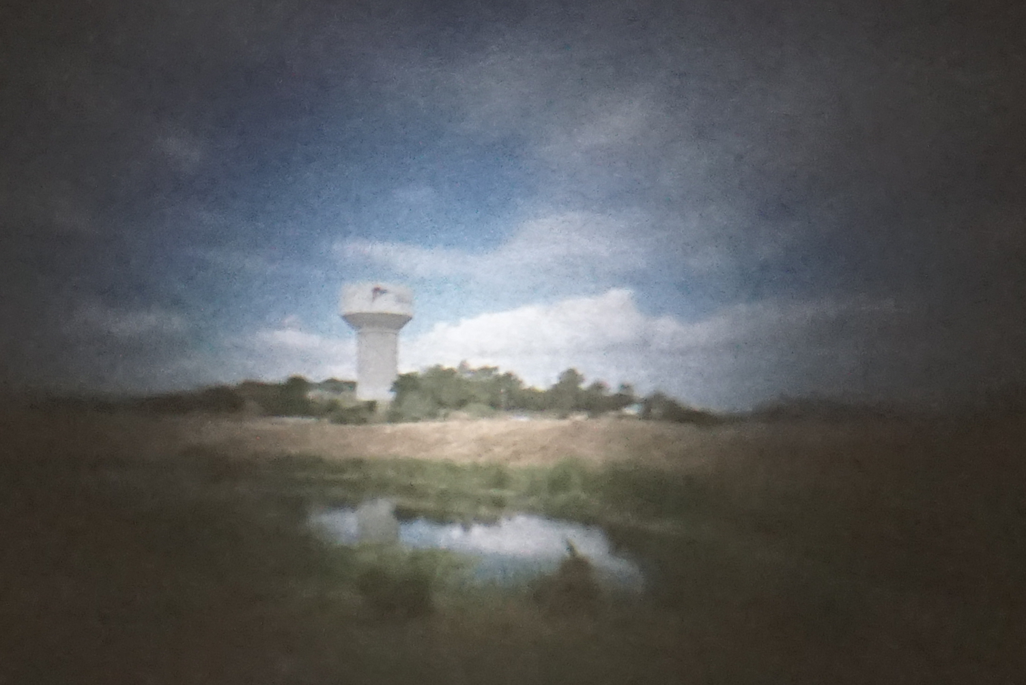
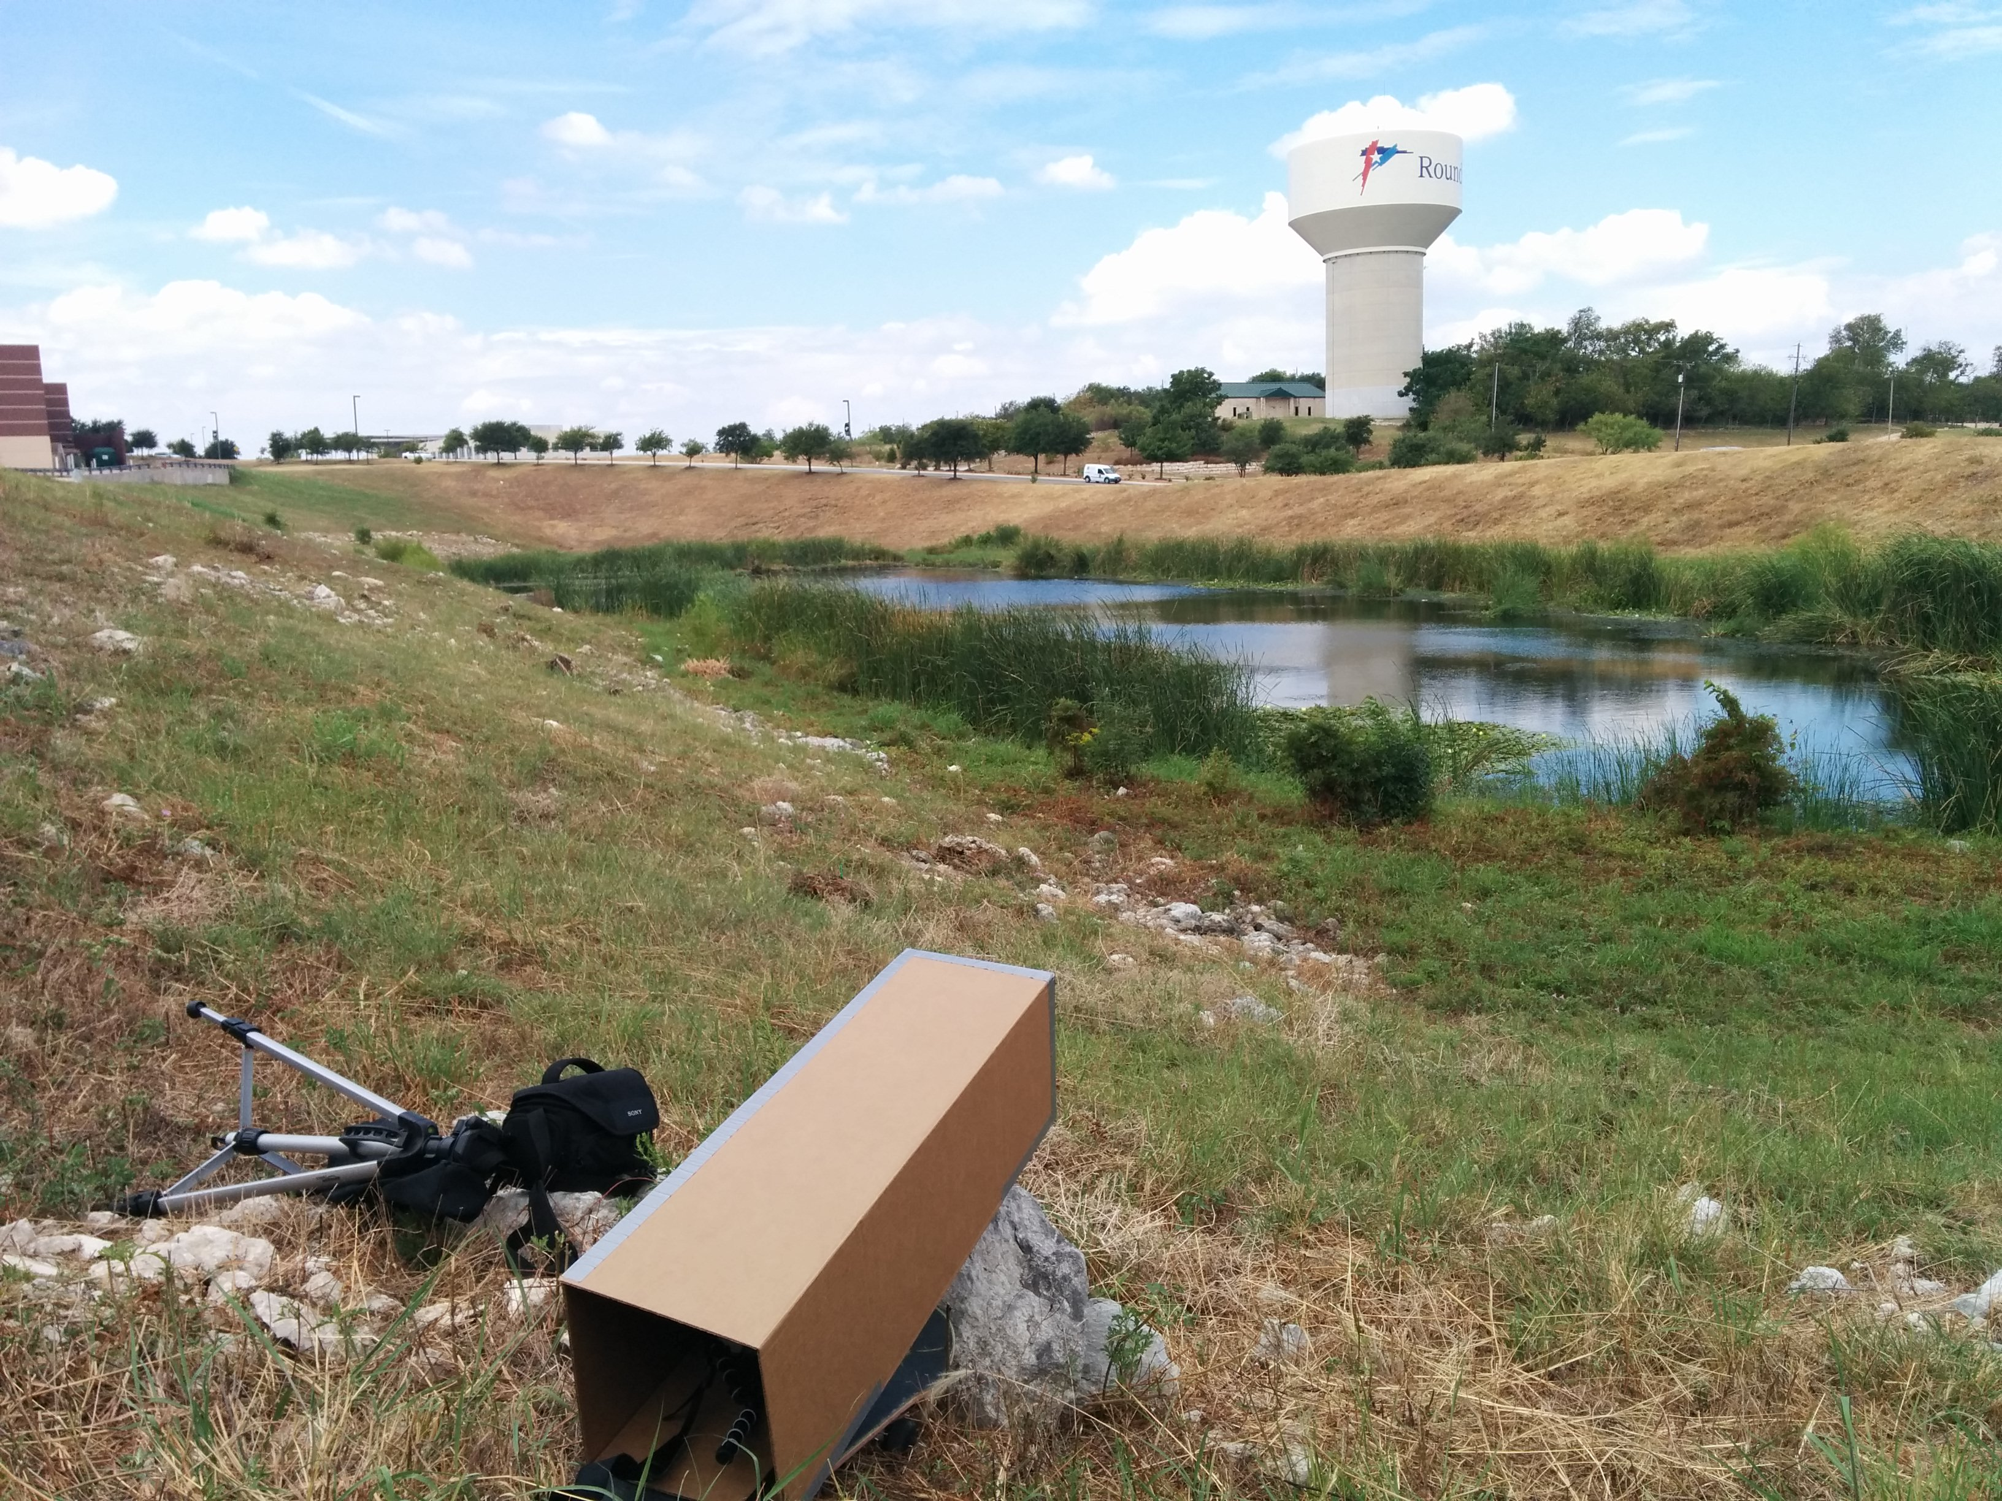
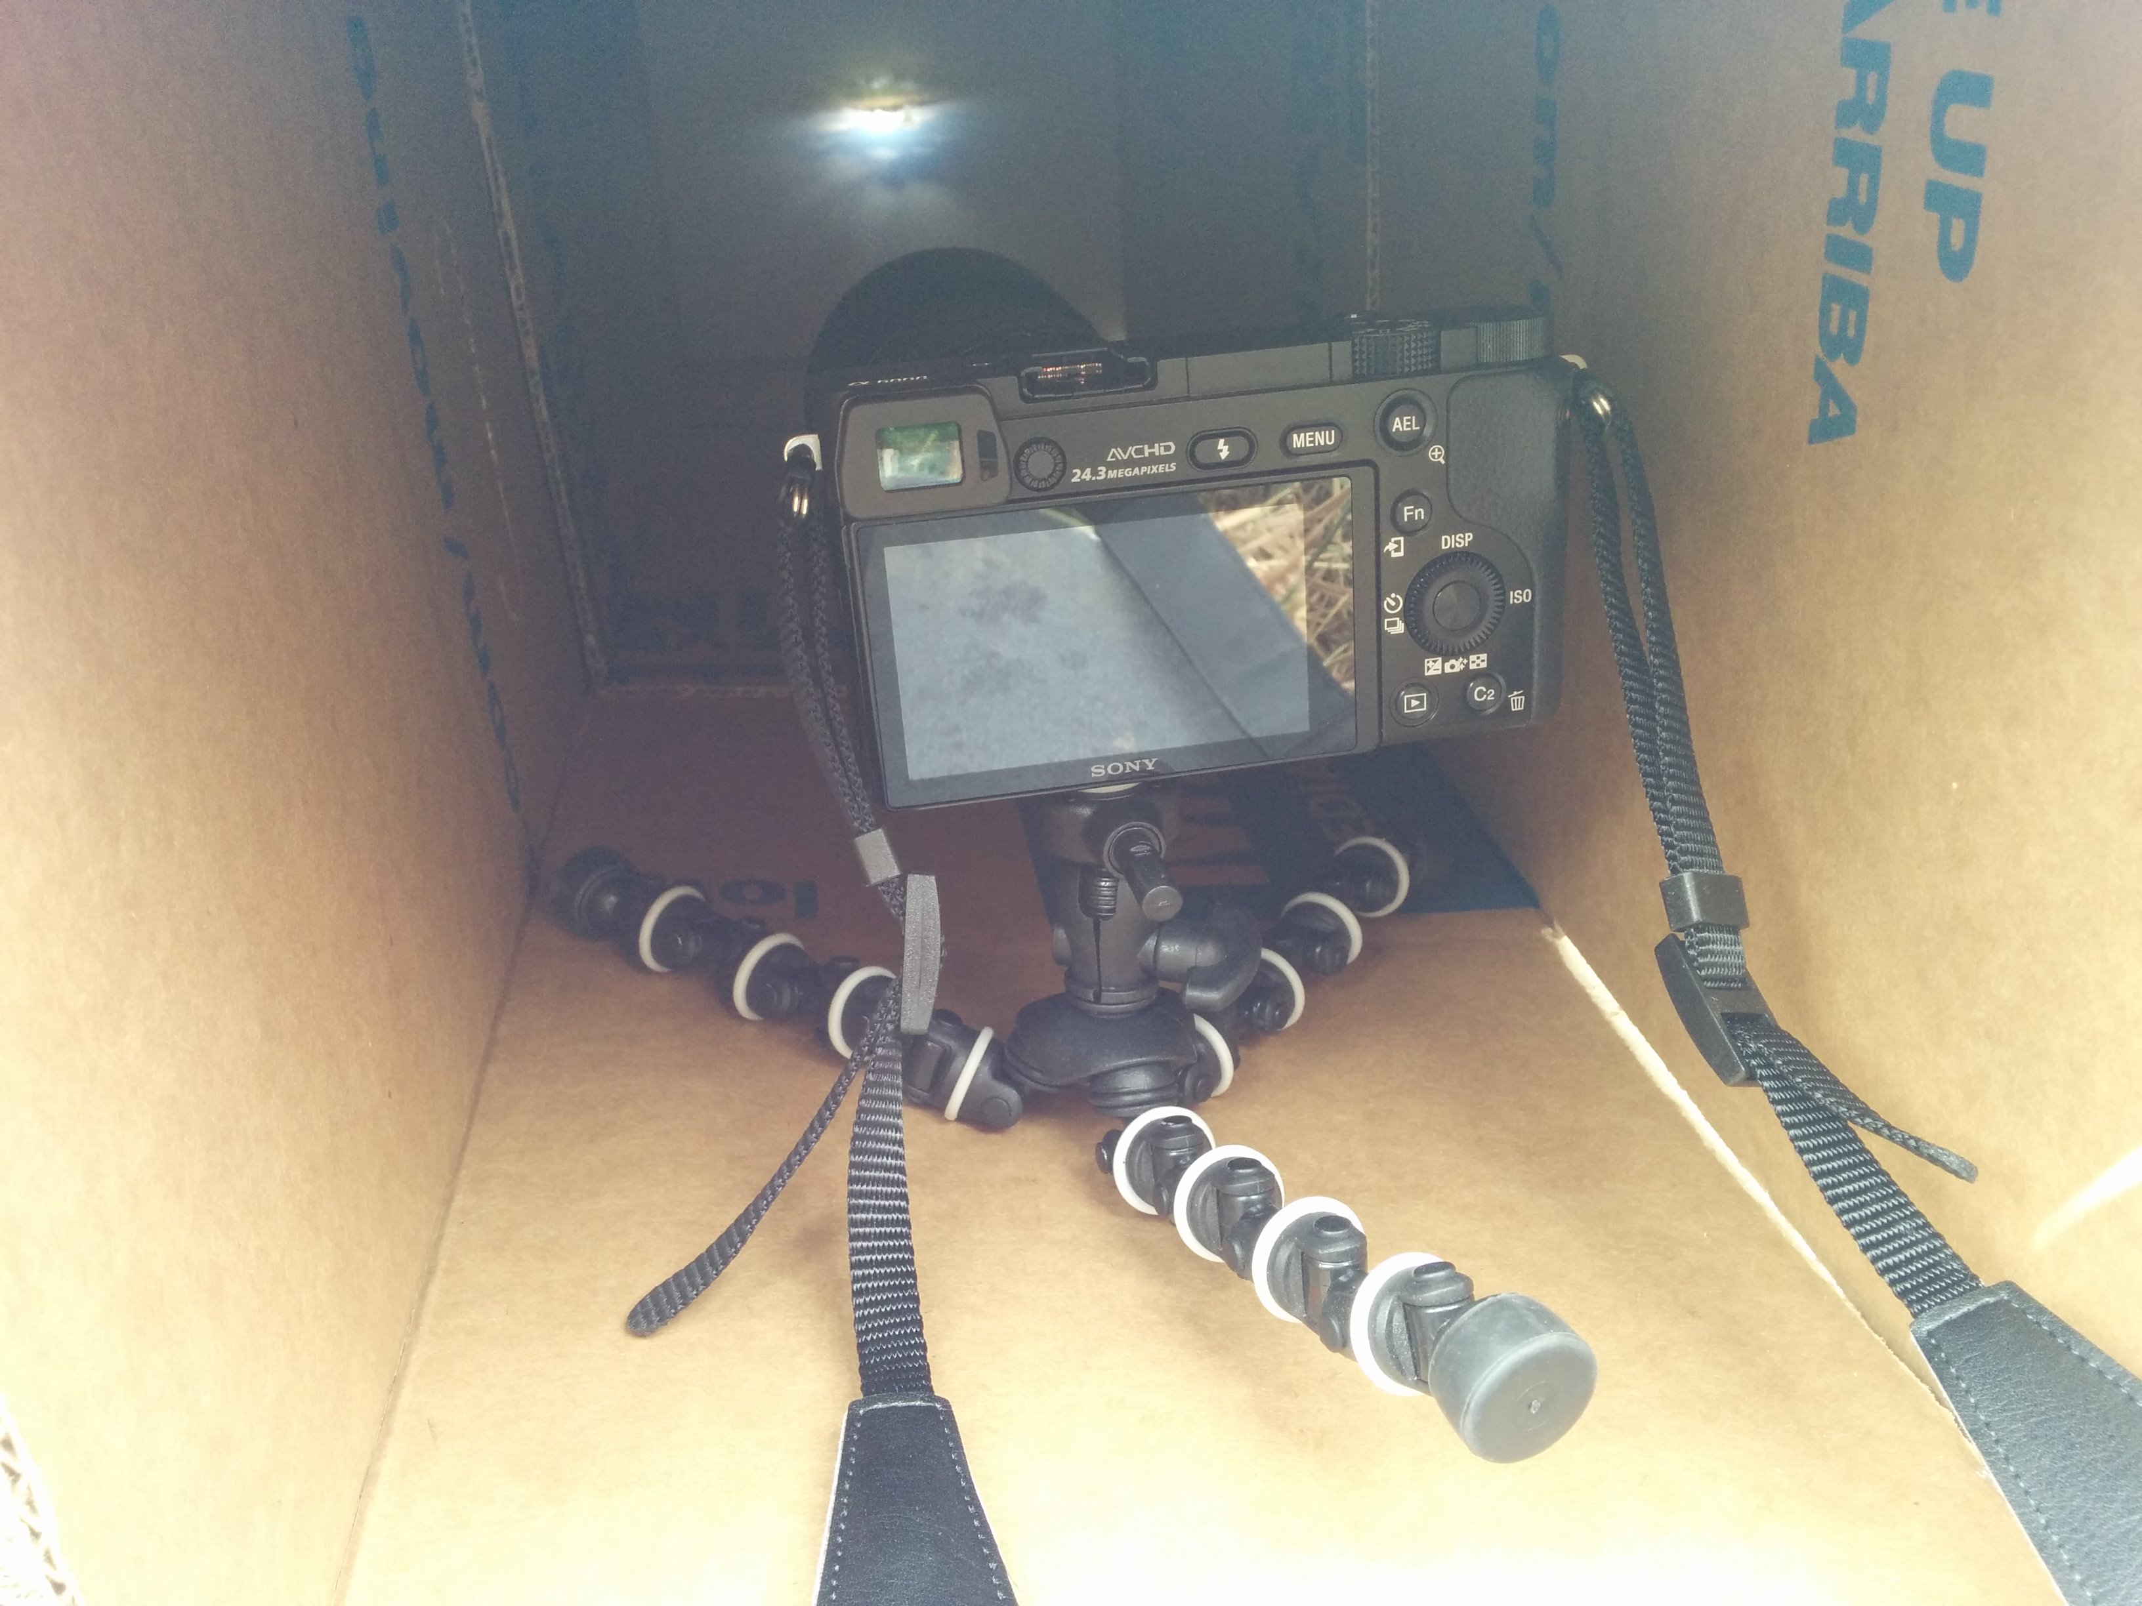
The Setup
The Scene
The Image
I built my own camera obscura out of a cardboard box and tracing paper. With considerable effort, I attempted to capture an outdoor landscape of a water tower.
CS 6475

Slide 3
What was the site of your camera obscura experiment?
The site of my camera obscura experiment was a water tower in Round Rock, Texas. I stood a few hundred meters from the tower to include a nearby pond in the foreground of the image. This also allowed me to have a nice blue, partly cloudy sky as a backdrop.
CS 6475

Slide 4
2. Why was it appropriate? What did you have to do to make it appropriate?
This scene was appropriate because it was very well illuminated (images were taken around high noon). The bright outdoor scene creates a better image for the camera obscura, which houses a screen in near complete darkness. For the best results, I had to ensure that very little light penetrated the box housing of the camera obscura.
CS 6475

Slide 5
3. Was the image visible to naked eye?
Yes, the image was visible to the naked eye. Because the outdoor scene was very well illuminated, I did not need to use a long exposure to capture the final image. However, the result was grainy/blurry, reminiscent of an old low-resolution camera. Perhaps if I chose subjects closer to the camera, it would have improved the contrast and overall resolution.
CS 6475

Slide 6
4. Who helped you with this assignment? In what way?
I was inspired to build my own camera obscura after watching the video linked in the assignment description. Nobody else helped my physically, but I did use a local machine shop to build the camera and make precise pinhole cuts in the cardboard.
CS 6475

Slide 7
The “Scene”
A landscape view of a water tower and pond in Round Rock, Texas. I chose a bright, partly cloudy day in an attempt to capture a nice skyscape.
CS 6475

Slide 8
The “Image”
This was captured using a ¼ inch pinhole and 5x magnifying lens. The final image was quite blurry, but you can make out the water tower and even see the painted symbol.
I rotated the image 180 degrees and cropped the image to remove the blank parts of the screen. The image only took up ~1/3 of the overall screen size, which was 9” x 9”.
Camera settings:
f/5.6
1/200 second exposure
ISO-3200
CS 6475

Slide 9
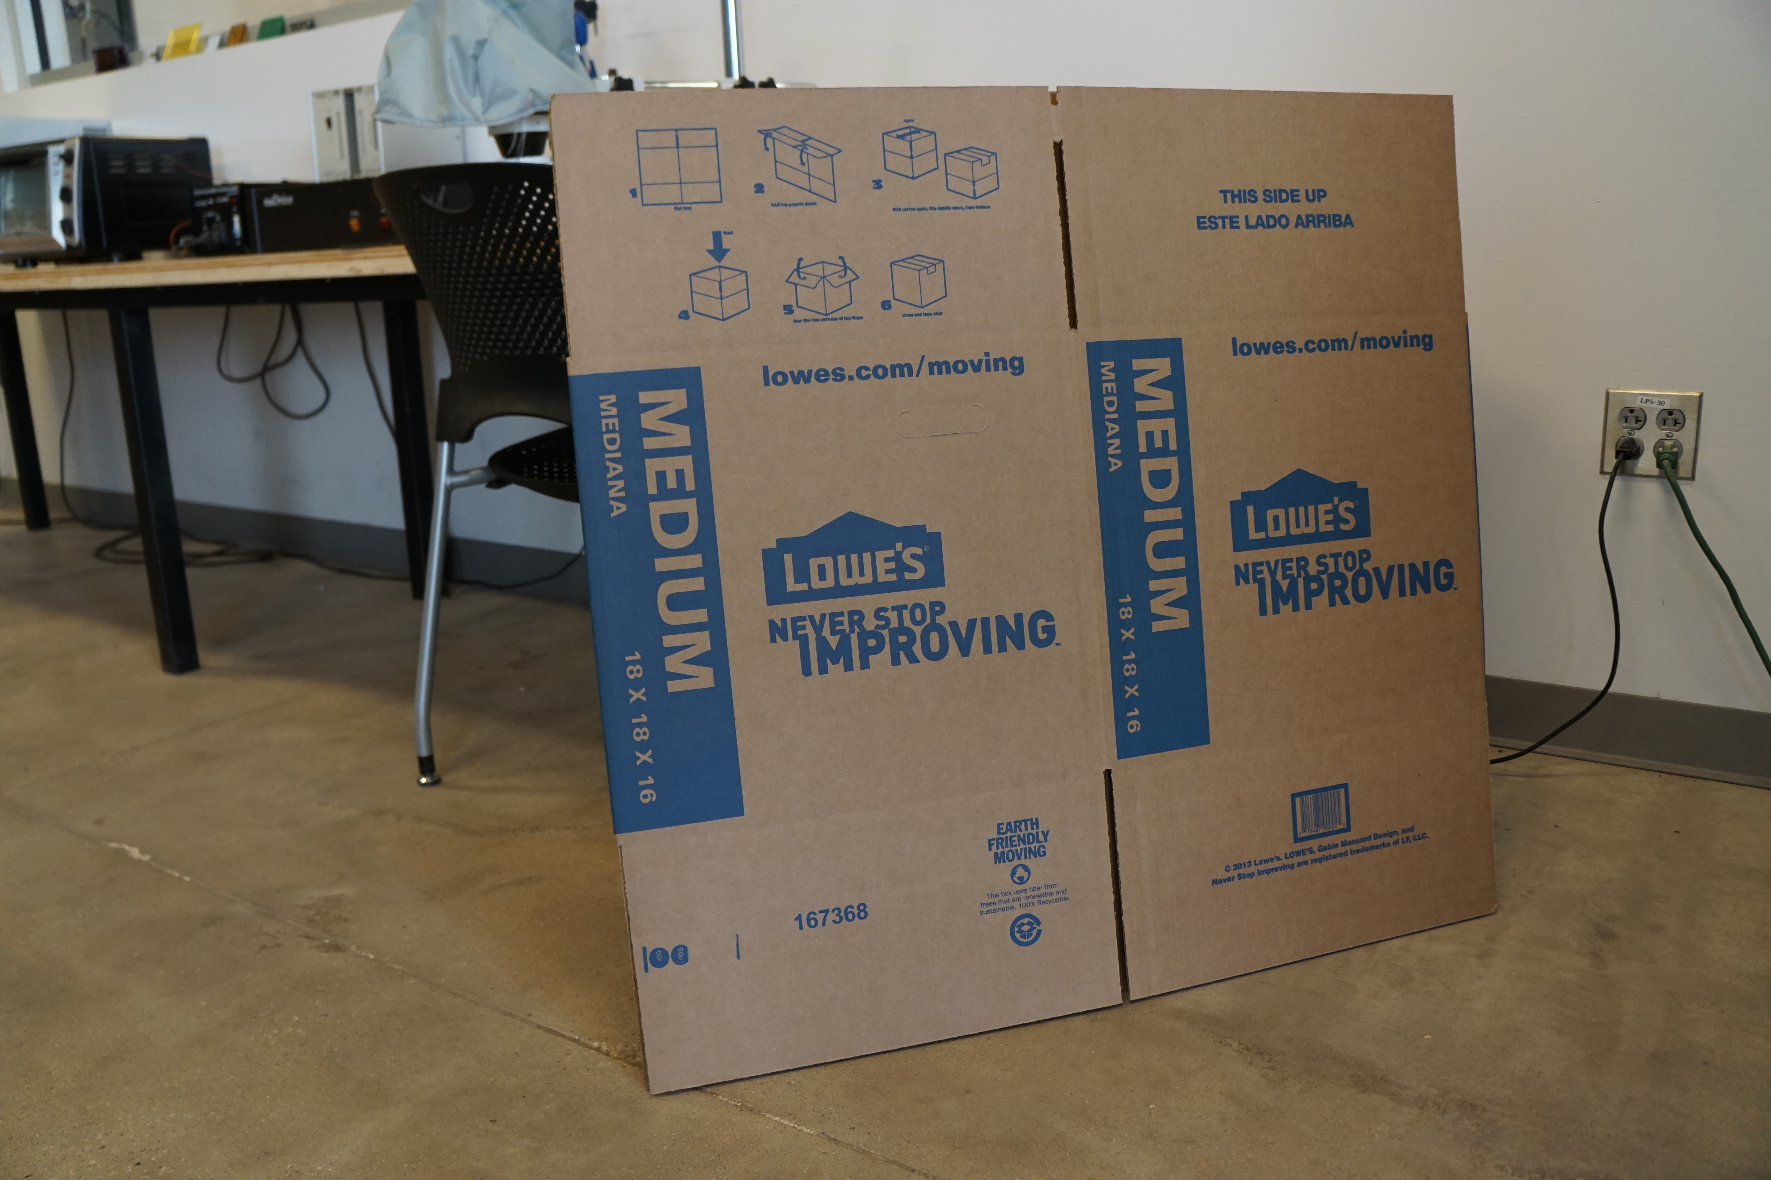
The “Setup”
It all started with a cardboard box.
CS 6475

Slide 10
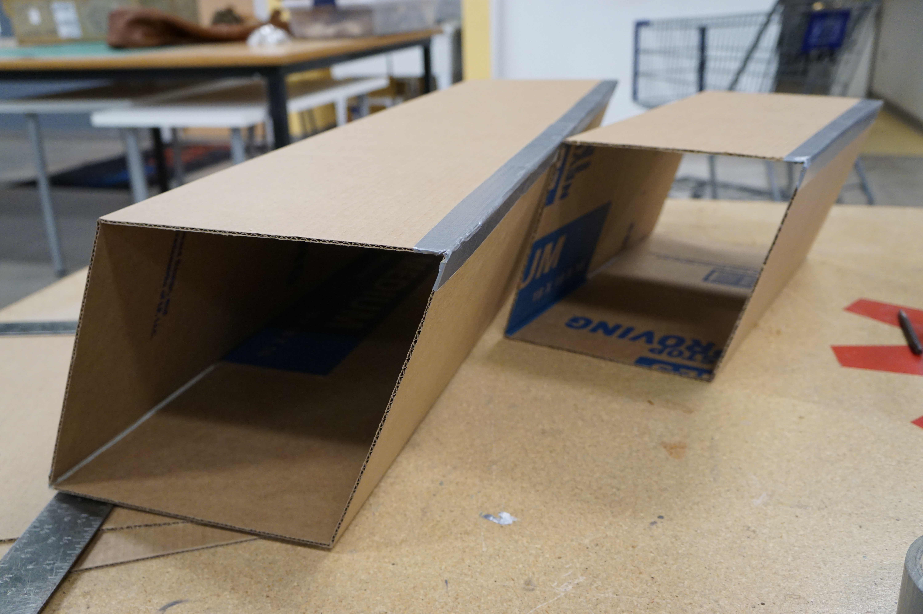
More Info/Setup
Cut, fold, and tape the cardboard into two rectangular prisms. One is half the length.
CS 6475

Slide 11
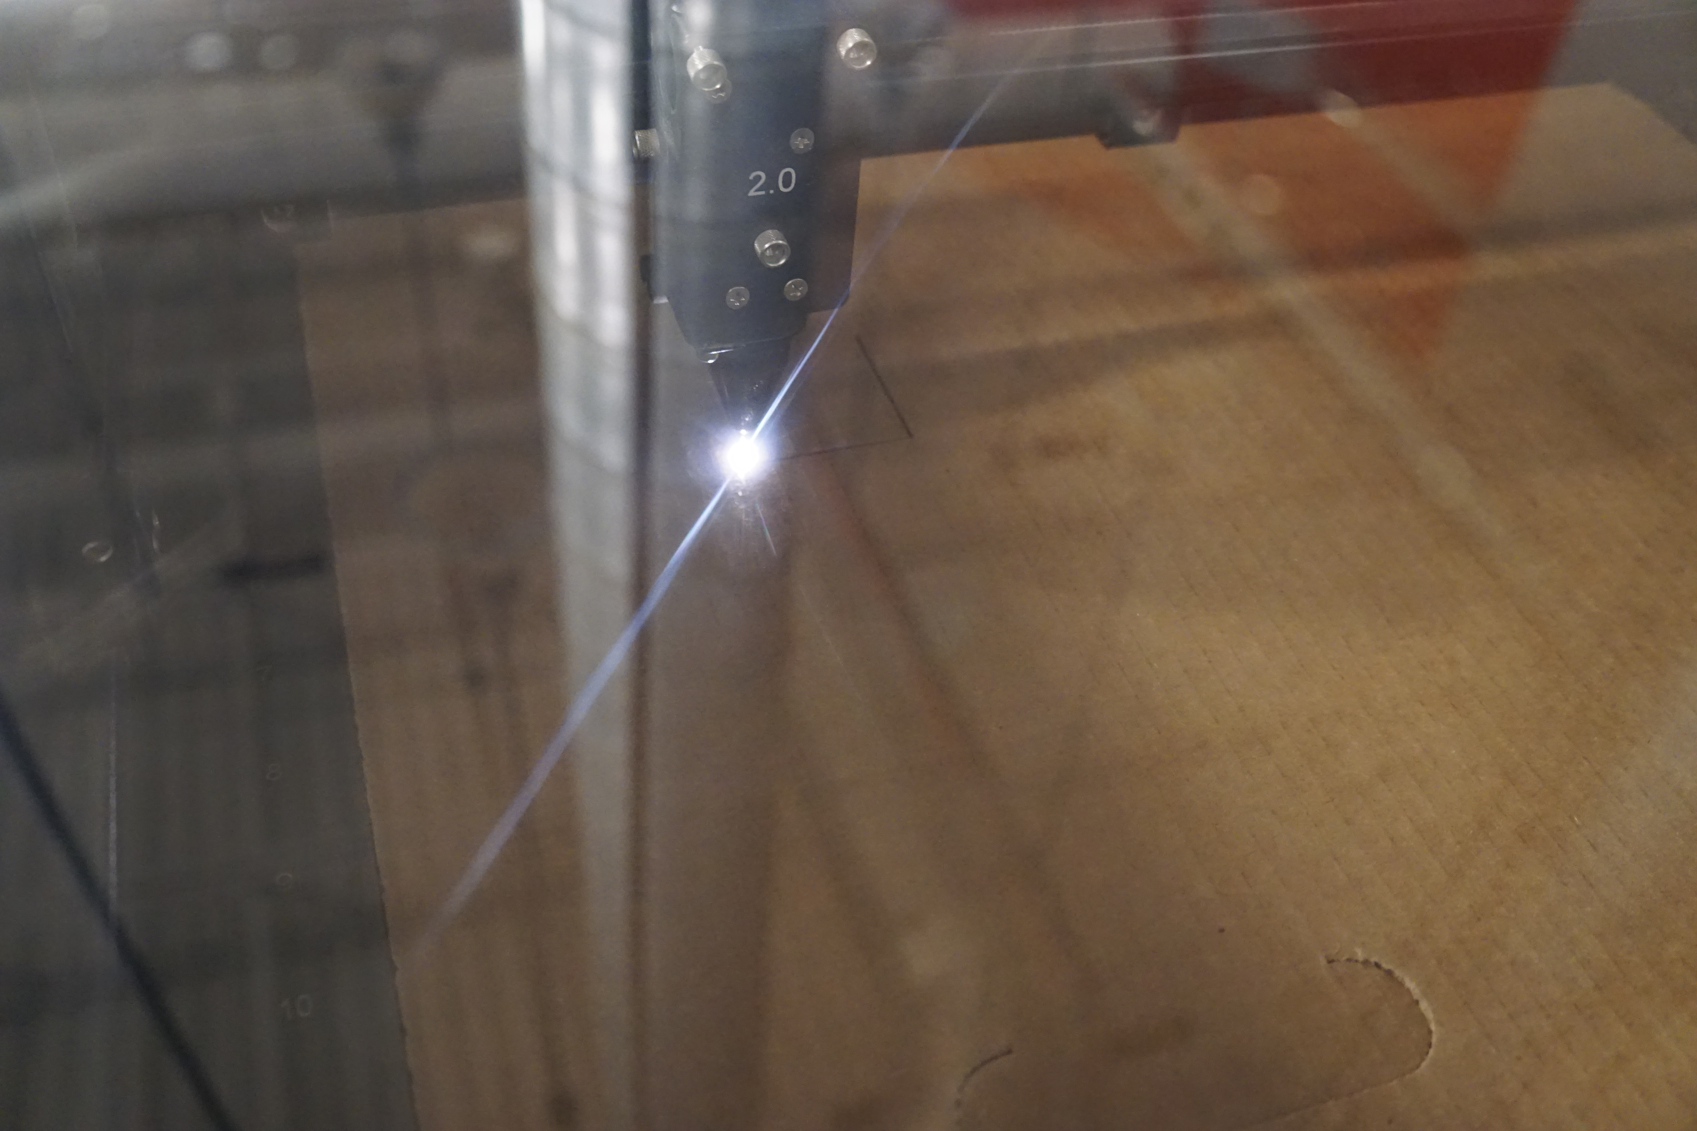
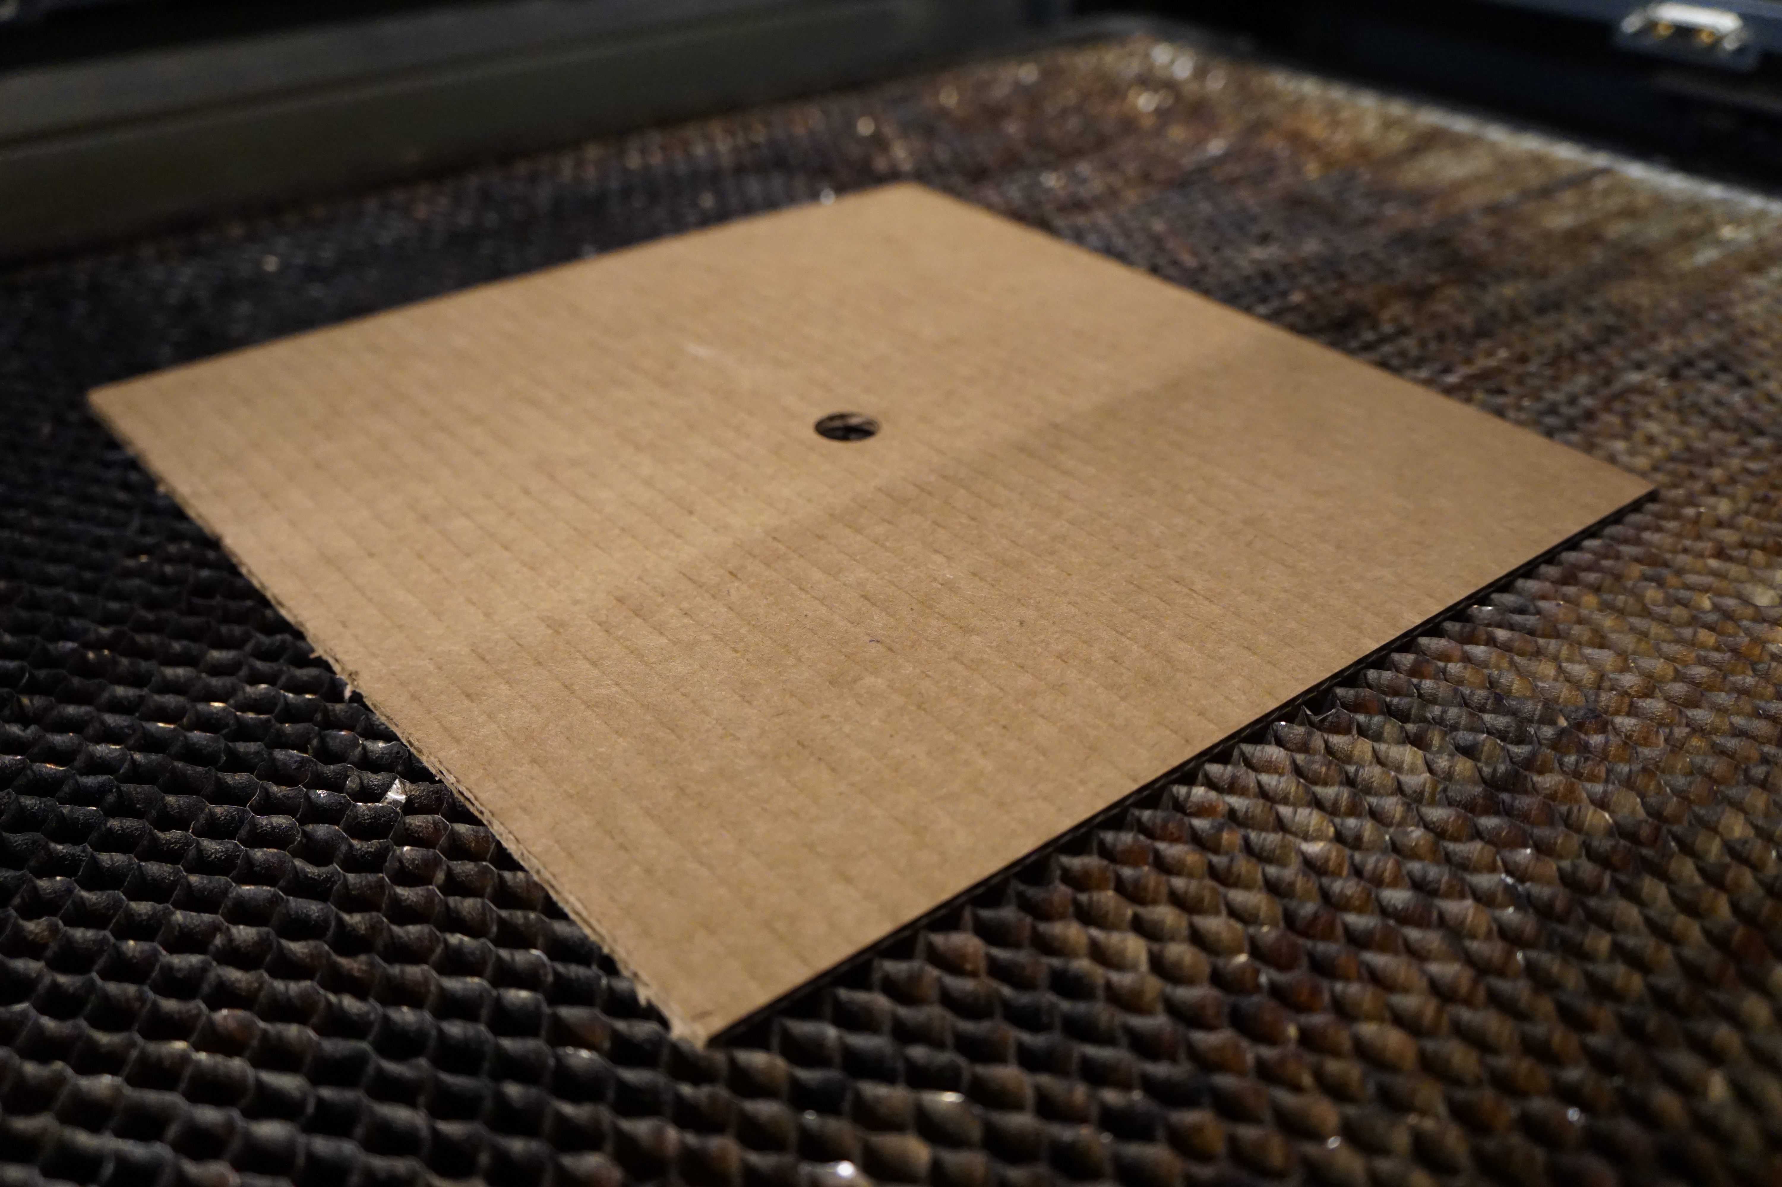
More Info/Setup
I used a laser cutter to create precision cuts for the pinhole, or aperture size. This image shows a pinhole of ½ inch.
CS 6475

Slide 12
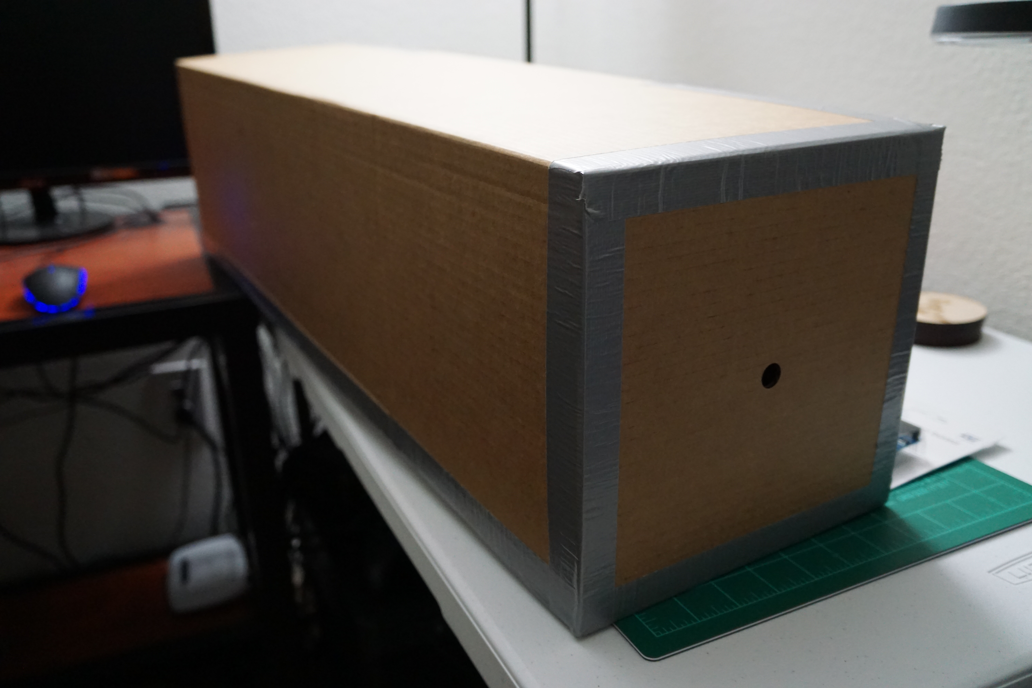
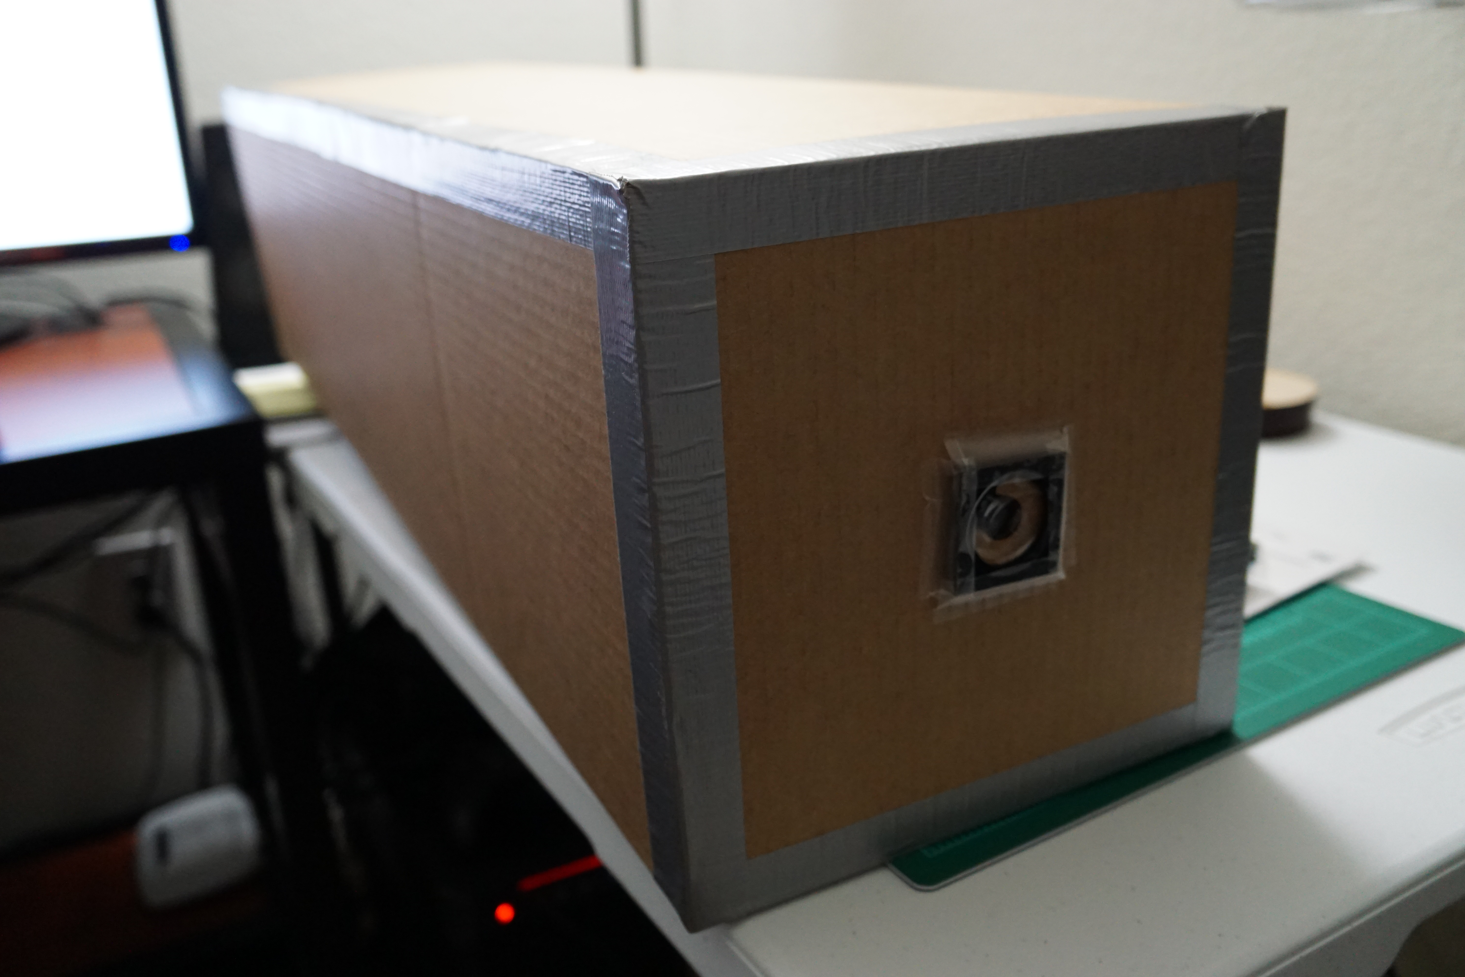
More Info/Setup
Add the pinhole cardboard piece to the larger rectangular prism. Make sure that light can only enter through the pinhole!
Affix a lens in front of the pinhole. Here, I used a 5x magnifying lens that I salvaged from an old toy.
CS 6475

Slide 13
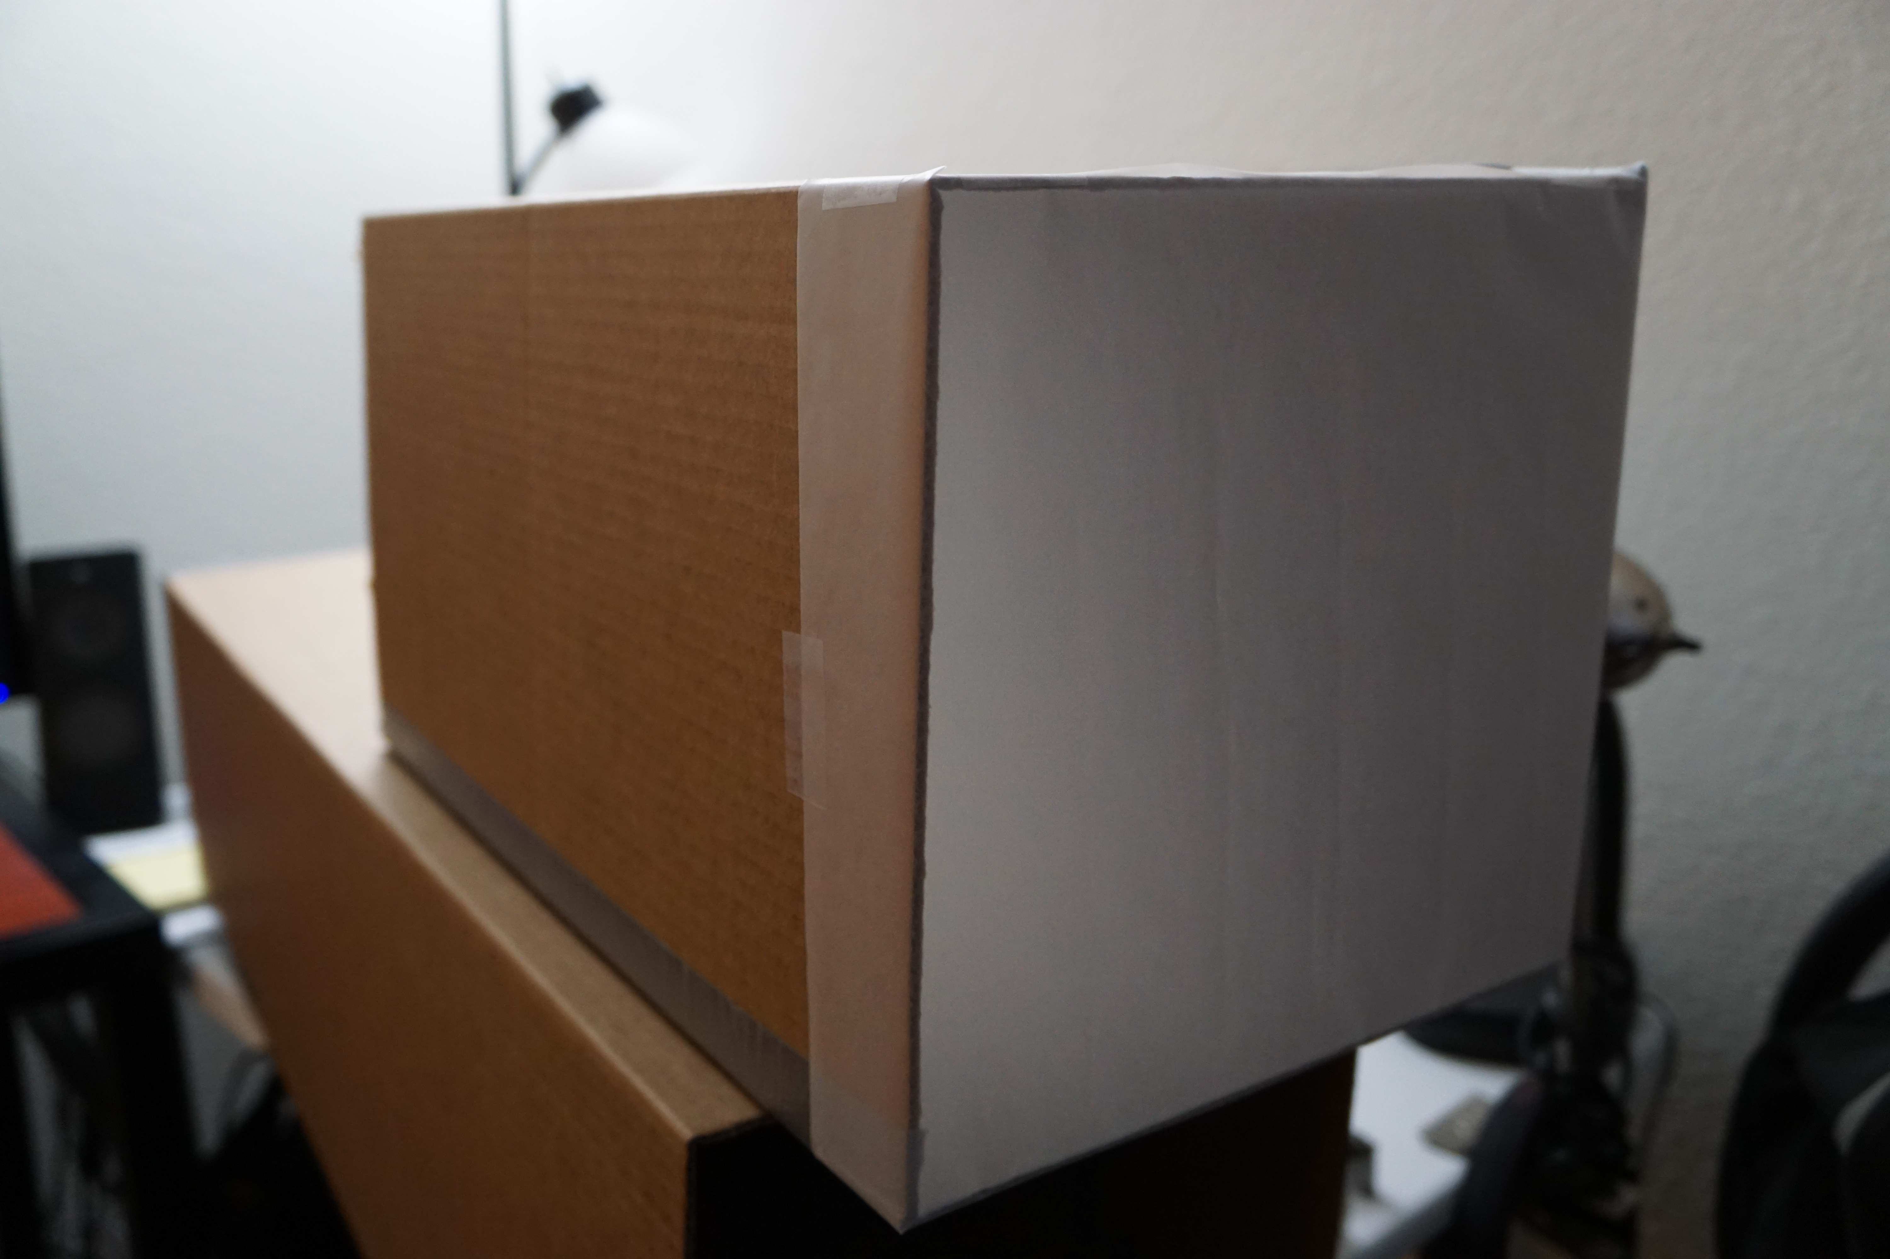
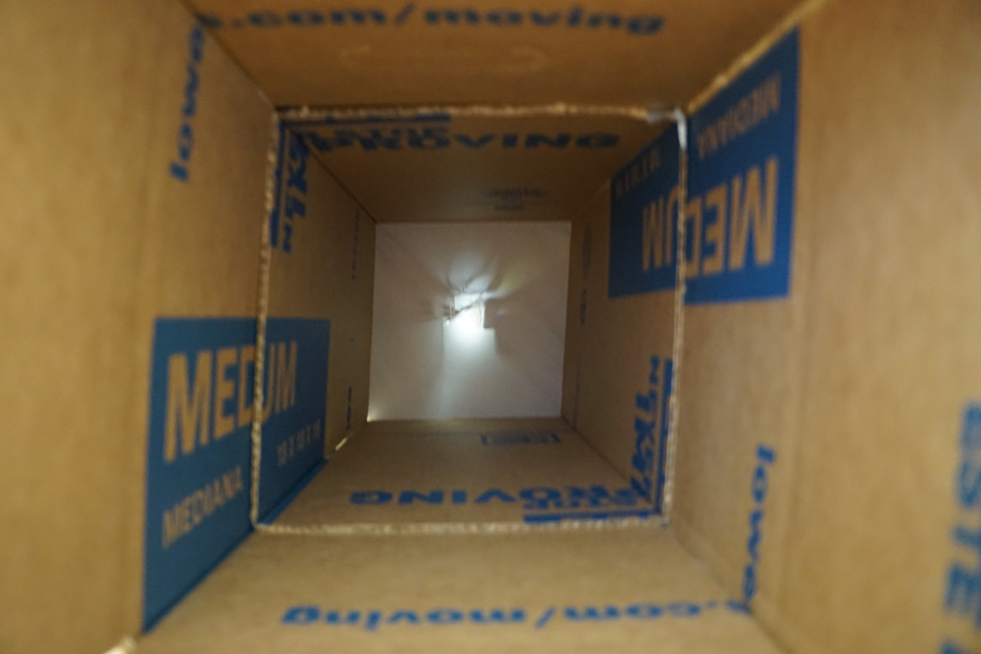
More Info/Setup
Add tracing paper to the smaller rectangular prism. This will serve as the “image sensor” or screen for the camera obscura.
Insert the smaller rectangle into the larger one. Adjust the screen distance to put the image in focus. This distance is a factor of the lens, pinhole size, and wavelength of the light.
CS 6475

Slide 14
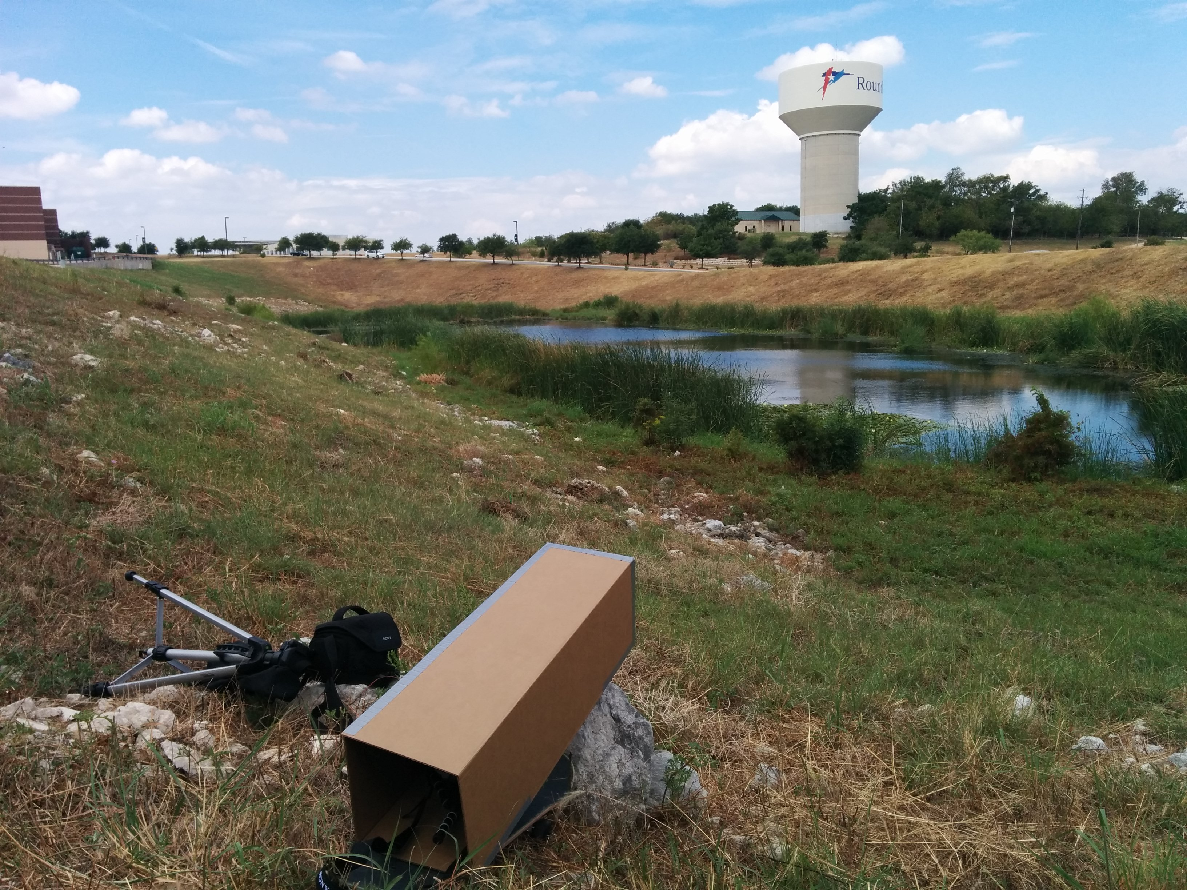
More Info/Setup
Insert a camera into the backside and aim the camera obscura toward the scene. The digital camera will capture the image captured by the camera obscura. Note, the image will be upside down.
CS 6475

Slide 15
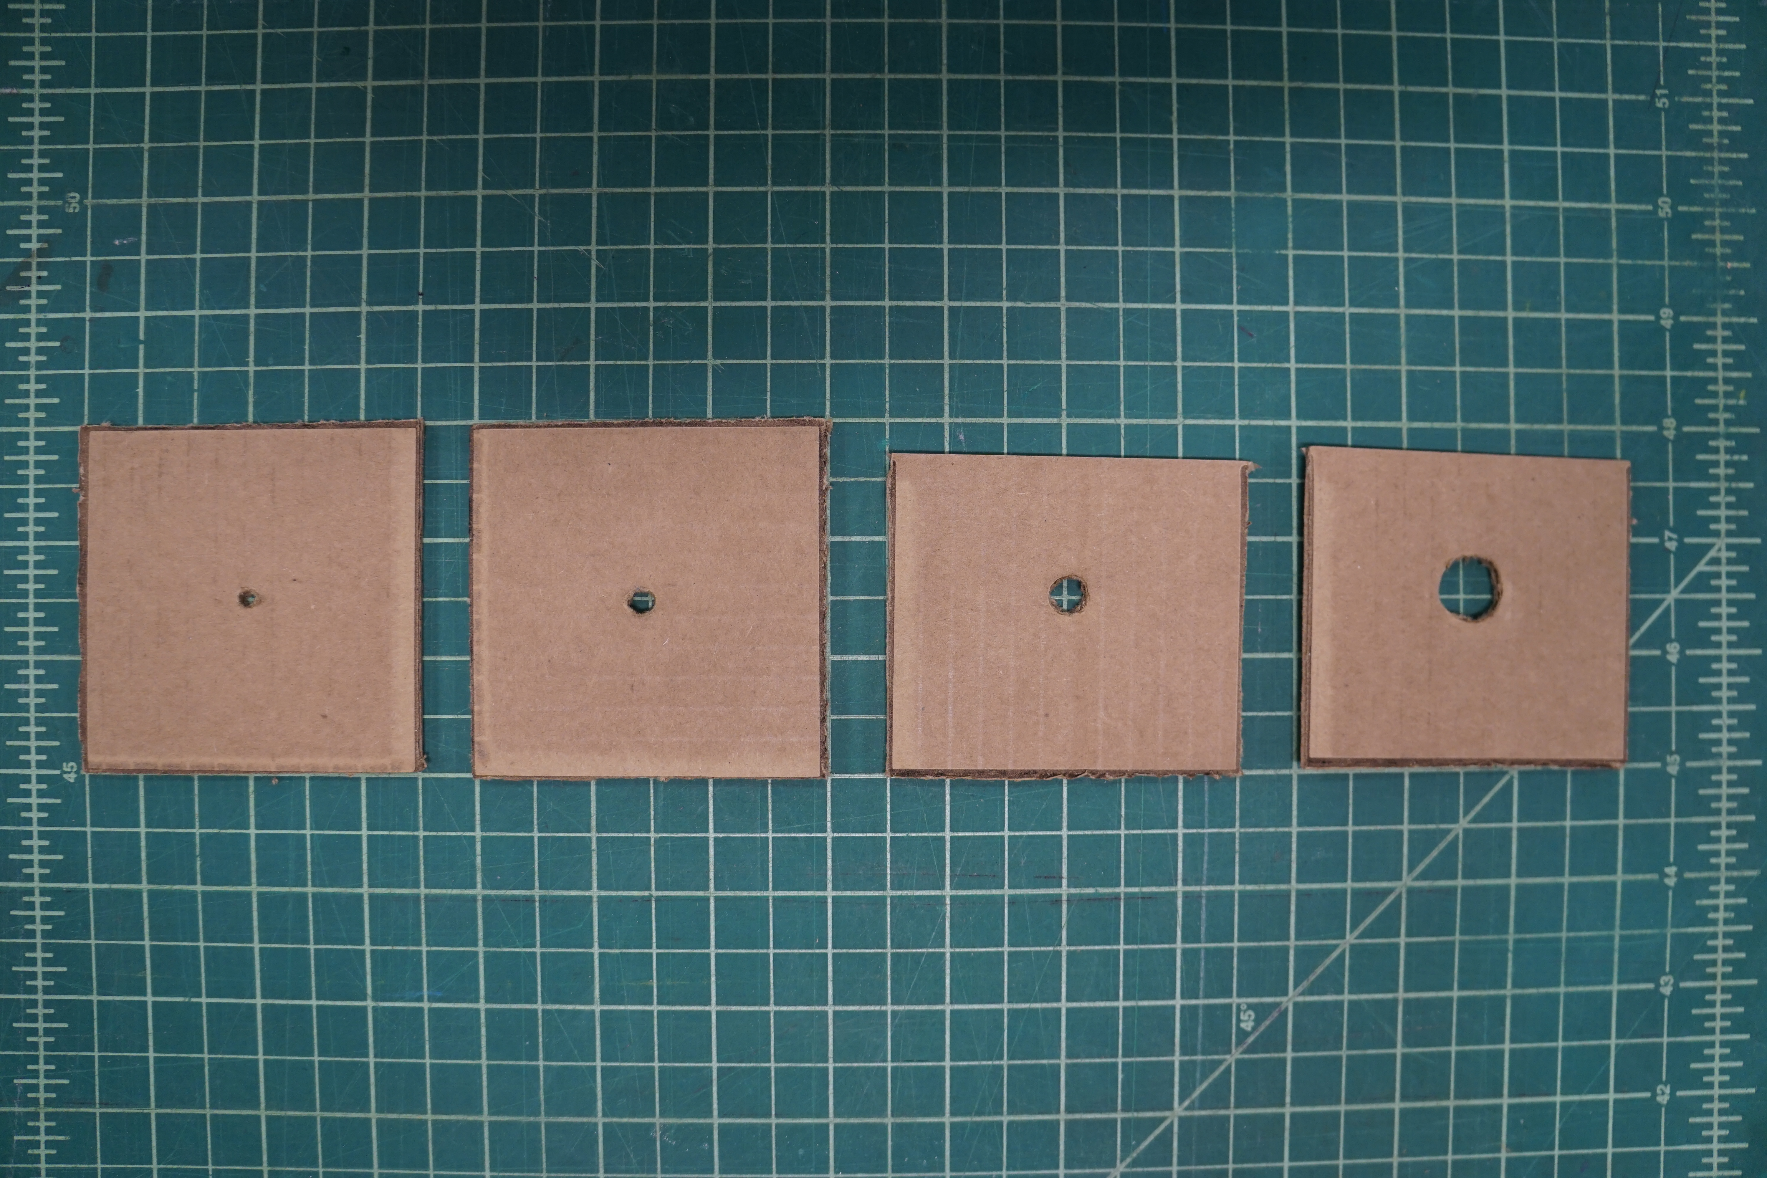
More Info/Setup
I also played around with using different pinhole sizes to see the effects on the resultant camera obscura image. I tested with ½ inch, ¼ inch, 1/8 inch, and 1/16 inch aperture sizes.
CS 6475

Slide 16
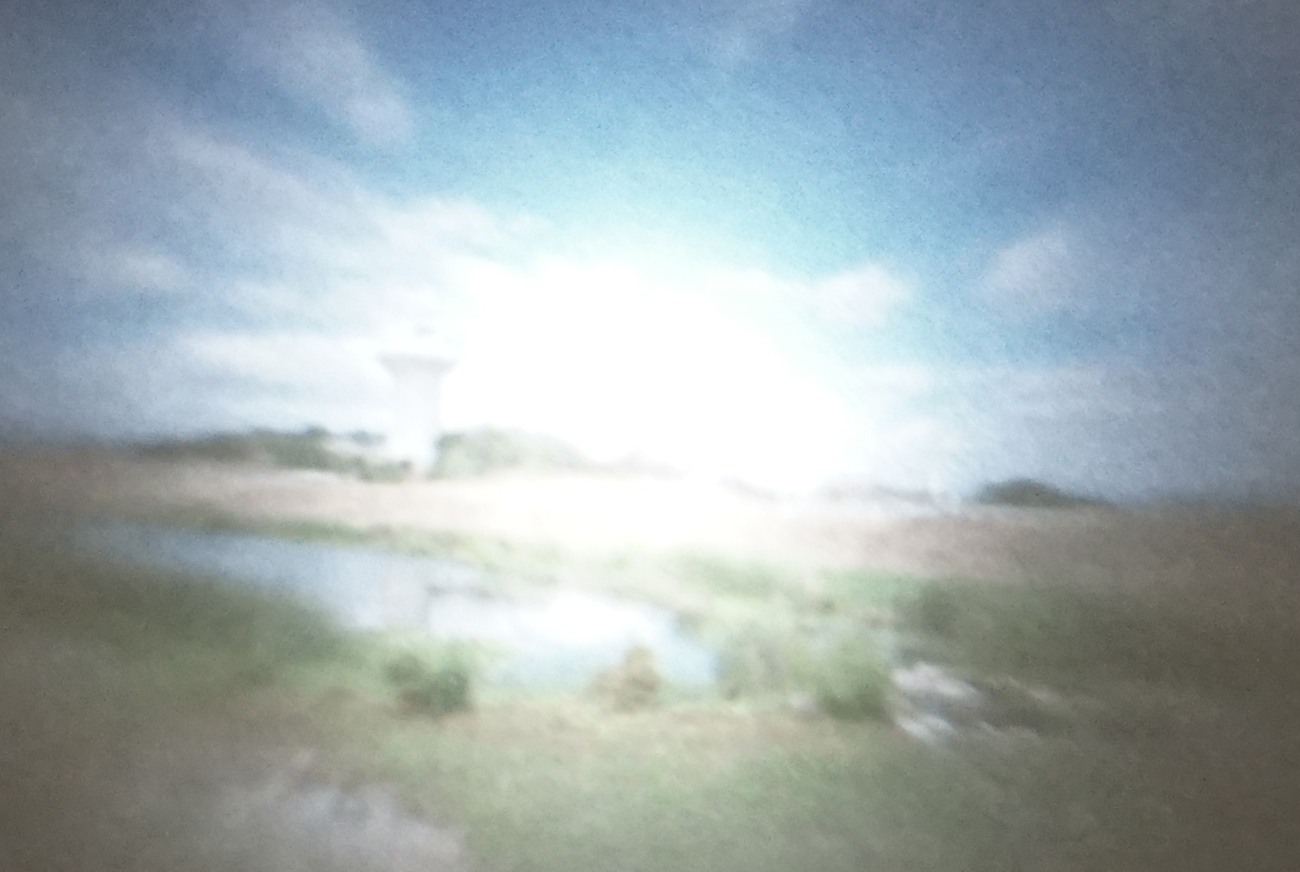
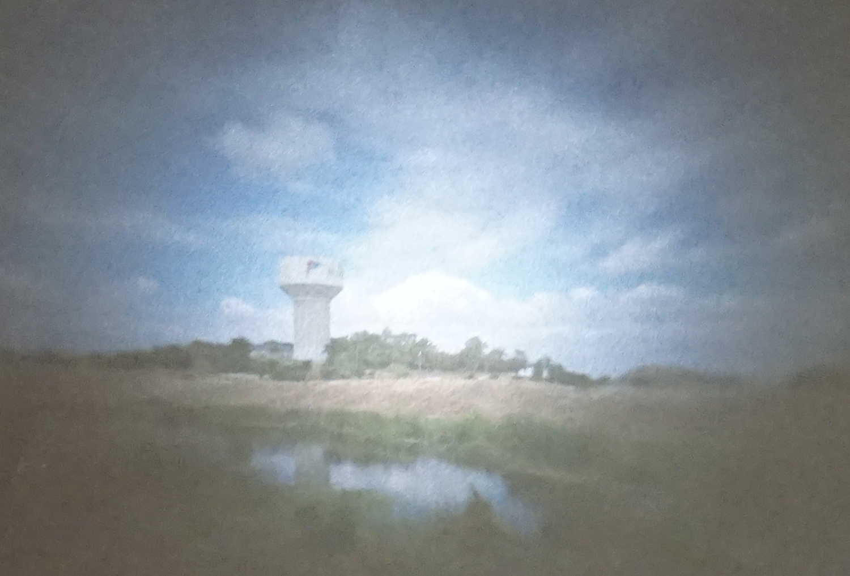
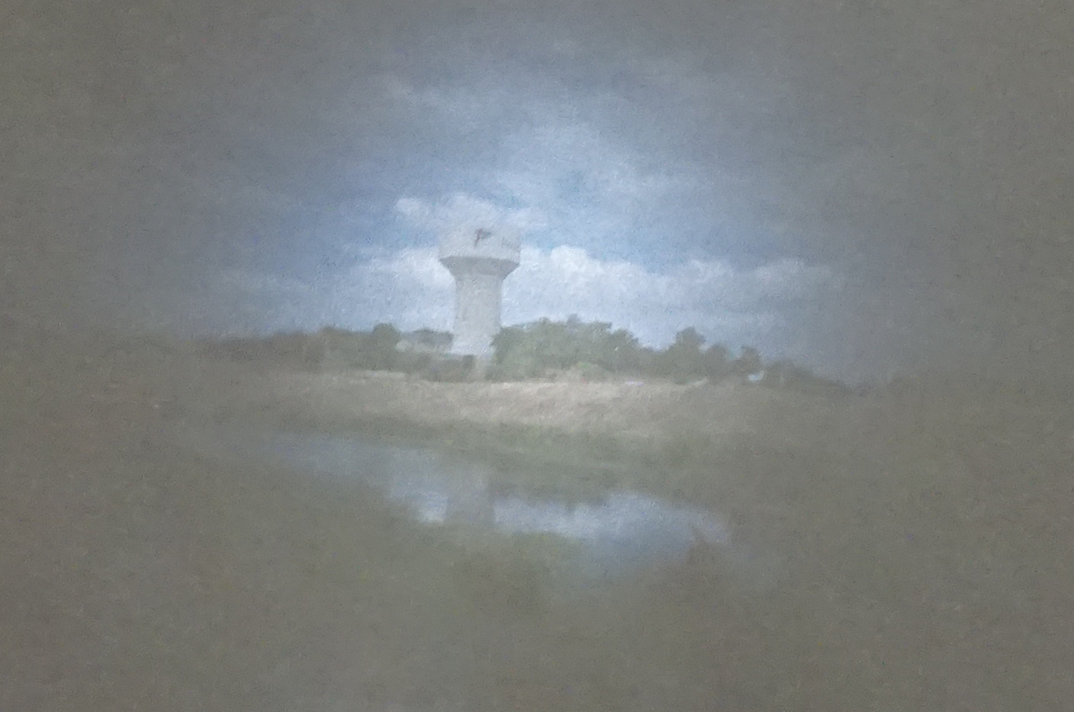
½ inch
¼ inch
More Info/Setup
I think the best result was the ¼ inch pinhole. The ½ inch let in too much light, and the smaller pinholes let in too little. This caused the final image to be over- or under-exposed. However, the image started to get sharper as pinhole size got smaller. I would need to play around with exposure times to take advantage of this.
1/8 inch
1/16 inch
CS 6475

Slide 17
More details
I enjoyed this project because it gave me a hands on experiment to learn how simple cameras work. It is always cool to see optical physics theory working in action! Next time, I’d like to enhance the camera with variable pinhole apertures and build some sort of interchangeable lens system. I also believe the cardboard body can be further optimized to be smaller (more portable). I’d also like to test different scenes with subjects closer to the camera.
CS 6475

